Slide 1
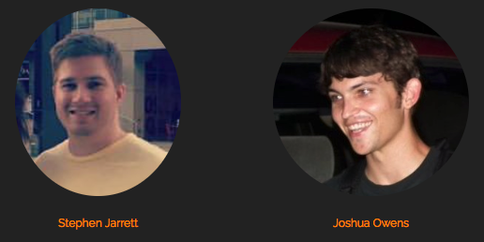
RepSearch: A Foray
June 6, 2018

Slide 2
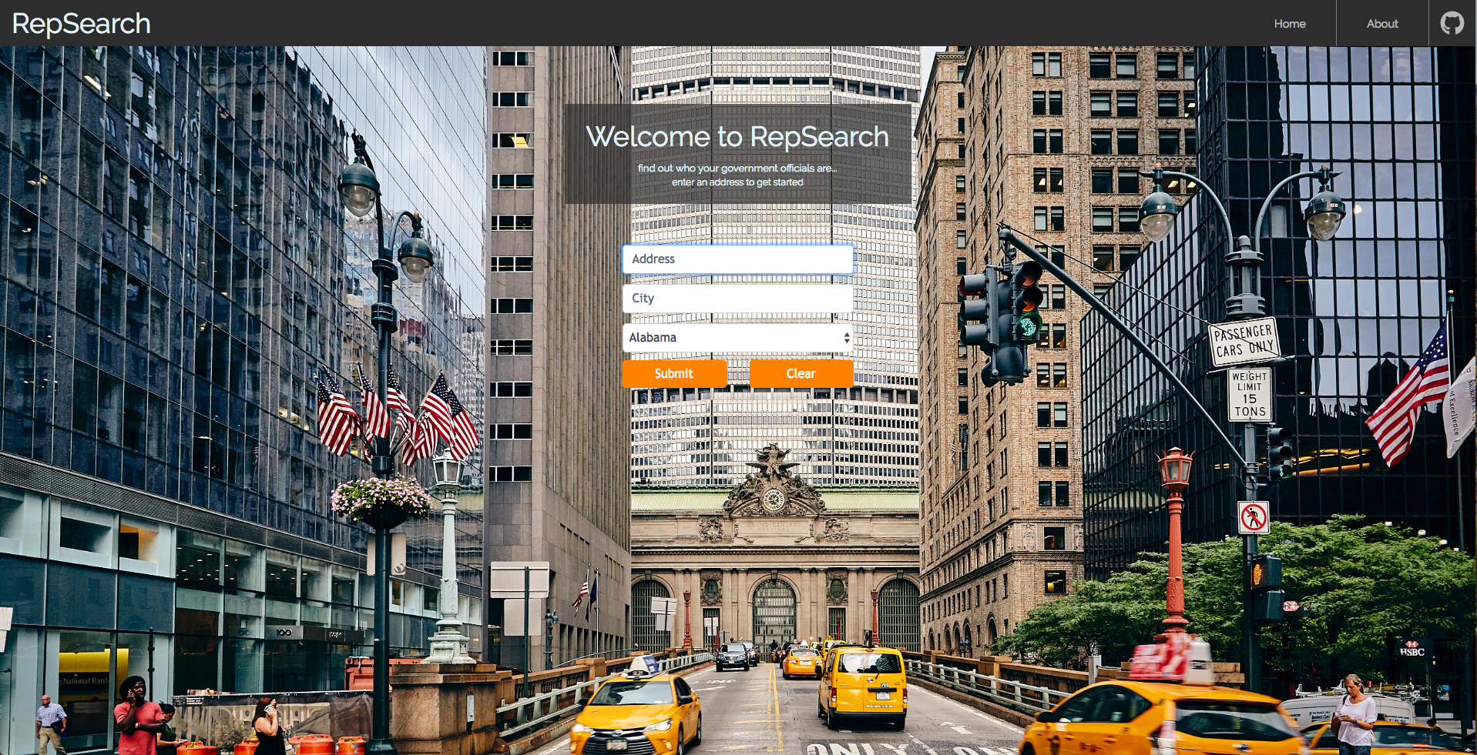
Who’s in charge?
RepSearch is an application for obtaining information about elected officials in a given constituency.

Slide 3
What’s it do?
After entering a physical U.S. address, government officials at the local, state and national levels appear on-screen, complete with a photo (if available) and details about rank, party affiliation, associated website and news articles, as well as social media presence.

Slide 4
Demo!

Slide 5
Recommended really good tools
Google Fonts
Free and easy to use
Unsplash
Free, high-quality images
No attribution necessary
Behance.net
Compelling web design templates
Popper.js
JS library for positioning computation
<link
href="https://fonts.googleapis.com/cs
s?family=Fjalla+One" rel="stylesheet">
.CSS-class {
font-family: "Fjalla
One", sans-serif;
}

Slide 6
Features for the future
NY Times Article Search API
Figuring out a way to weed out irrelevant results
Mastering the pop-up
Ensuring that no more than one popup is open at a time
Setting a smart body-level listener for focusing out
Non-standard or poor-quality images
Box shadow is an eyesore if the image doesn’t fit the container
Some images were too low quality and grainy

Slide 7
Things we’re proud of
Nice auto-scroll when submitting form
$('html, body').animate({
scrollTop: $(".form-outer-container").outerHeight()
}, 1000);
Re-purposing getOfficials() to handle a subset of officials
Used a pipeline approach
Refer to JSON response in local storage
Using listeners to dynamically pull data
Prevents making all API calls on loading the page
Only requests the desired data when it’s needed

Slide 8
Fire Ze Missiles!
function addDivisionListener(button, officeArray) {
button.on("click", function(event) {
event.preventDefault();
var offices = [];
var officials = [];
if (officeArray) {
offices = getOffices(officeArray);
}
if (offices) {
officials = getOfficialsByOffice(offices);
}
getOfficials(officials);
});
}
officeArray comes from the selected division
which then grabs the appropriate offices
which then grabs the appropriate officials
which then gets gotten on the page

Slide 9
Lessons learned
Design
Padding, padding, and more padding!
Lean toward small font sizes
Stick with simple color palette: monochromes and one accent
Conflict resolution and the cadence of commitment
Good commits are atomic
Great commits are also well-defined and labelled
You are what you data
First understand what the dataset offers and what it doesn’t
Don’t force a square peg in a round hole – pivot when needed!

Slide 10
Q&A
Thanks for your attention and suggestions!

